Slide 1


SEO UNDER-PRICING CLASSIFICATION:
A FinTech Approach
GROUP 5
Glen Lasrado - 682830619
Md Rajib Hossain - 853079613
Taha Sameer - 837500930
Thu Do - 227018477
Yue Tang - 503816994
Zimeng Zhen - 624358088
Notes:
From consultant group 5 , team members, welcome
Pre
This project is designed to assist bank making more smart decision when it comes to

Slide 2


CONTENTS
Introduction
Datasets Used
Model Processing
Business Insights
Notes:
In today’s pre we will guide you through

Slide 3
Introduction
Feature Selection

Slide 4

BUSINESS PROBLEM
Objective: Predict SEO Underpricing
OBJECTIVE
Why does it matter? ​
Optimising Proprietary Trading Platform
Support the Investment Branch
Notes:
Begin with discussing why the project matters. As you know ,the up happends when
In the case of banks ,being able to accurately predict underpricing

Slide 5
Datasets Used
Feature Selection

Slide 6
DATASETS
SEO CRSP Dataset
S&P 500 Return
Define Dataset
S&P 500 Volatility Index
Model Processing
Consumer Price Index
Business Insights
US Interest Rate
Notes:
Market historical datasets
My team member will show

Slide 7
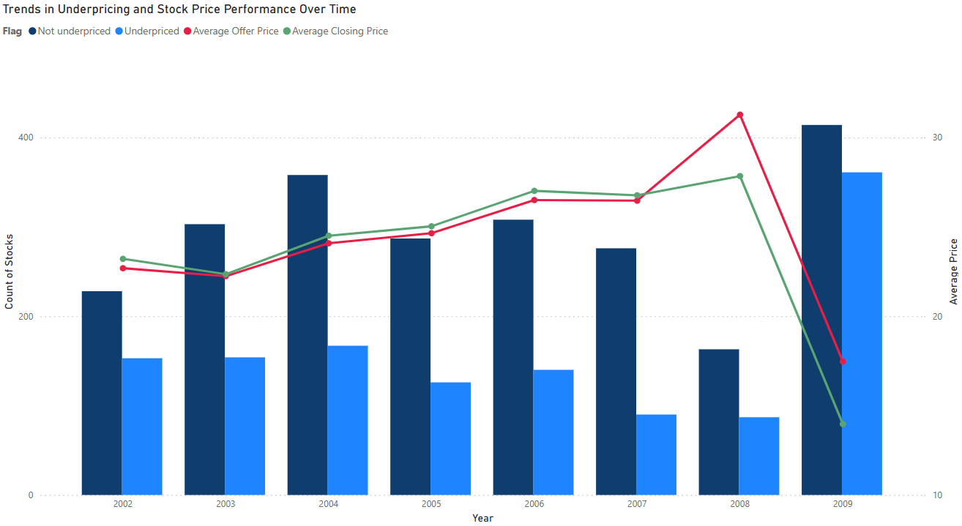
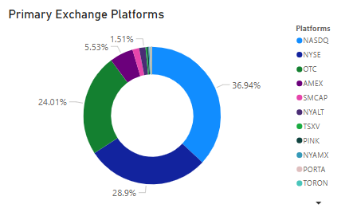
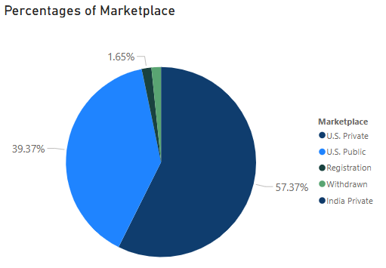
EXPLORATORY DATA ANALYSIS
SEO DATASET

Slide 8
EXPLORATORY DATA ANALYSIS
EXTERNAL DATASETS

Slide 9
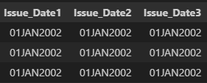
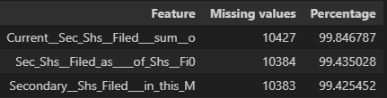
DATA MANIPULATION
Missing values
Duplicated rows/columns
Rows/Columns
Kept
Removed
Only US Public Marketplace
IPO Flag
Create new features
Imputed
Removed
Date Difference
Lagged Stock Price (Forward filled)
Market Cap
Deal Size as % of Market Cap

Slide 10

FEATURE SELECTION
S&P 500
Index Return
S&P 500
Volatility Index
Offer Price
3%
Random Forest
SEO CRSP Dataset
SEO Under-Pricing
Final Dataset
Best Features
Close Price
US One-month Interest Rate
Consume Price Index
Inflation Rate
One-Month Lag

Slide 11
TOP 20 FEATURES SELECTED
(Random Forest)
TOP 5 | IMPORTANCE
Offer Price | 6%
Deal Size as % of Market Cap | 6%
Market Cap | 6%
Common Equity before the Offering | 5%
S&P 500 Volatility Index | 5%
BOTTOM 5 | IMPORTANCE
Stock Return | 3%
Over-Allotment Amount Option | 4%
Shares Filed in Market | 4%
Gross Spread per Share/Bond | 4%
Principal Amount | 4%

Slide 12
Model Processing
Feature Selection

Slide 13
CLASSIFICATION MODELS
MODEL | ACCURACY | PRECISION | RECALL | ROC AUC
LightGBM | 67% | 48% | 42% | 65%
XGBoost | 66% | 47% | 42% | 64%
K-NN | 65% | 45% | 40% | 63%
Logistic Regression | 68% | 49% | 33% | 67%

Slide 14
Business Insights
Feature Selection

Slide 15
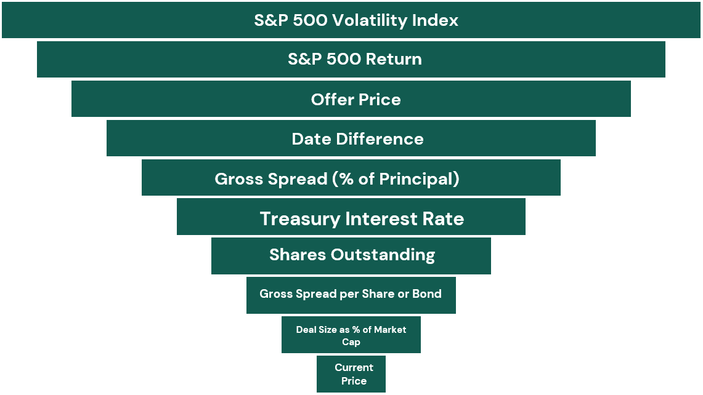
FEATURE IMPORTANCE
LightGBM TOP 10 FEATURES

Slide 16
CONCLUSION
FEATURES | RELATIONSHIP WITH SEO UNDERPRICING | IMPLICATIONS
S&P 500 Volatility Index |  | Higher Volatility → Higher Risk
Date Difference |  | Longer Gap → More Uncertainty
Shares Offered |  | Larger Supply → Higher Risk
Gross Spread |  | Higher Underwriting Fees → Riskier Deals
Deal Size Relative To Market Cap |  | Higher Deal Size → Higher Discount Demand
Treasury Interest Rate |  | Higher Rate → Higher Discount Demand
S&P 500 Return |  | Higher Return → Lower Discount Demand
Market Cap |  | More Stable → Lower Risk
Offer Price |  | Higher Offer Prices → Strong Company
Shares Outstanding |  | More Shares → Lower Risk

Slide 17
RECOMMENDATIONS
Hedge Against Market Volatility
Use Call Options or Futures
Long-Short Strategy
Manage Liquidity & Portfolio Risk
Avoid Overexposure to a Single SEO
Stagger Stop-Loss & Take-Profit Limits

Slide 18

LIMITATIONS & FUTURE IMPROVEMENT
LIMITATIONS
Limited Dataset Size
Limited Macro-economic Features
FUTURE IMPROVEMENT
Sentiment Analysis
Improve Data Size
Increase Company Specific Data

Slide 19
REFERENCE
Center for Research in Security Prices. (2025). CRSP/Compustat Merged Database – Security Daily [Data set]. Wharton Research Data Services. https://wrds-www.wharton.upenn.edu/
Center for Research in Security Prices. (2025). CRSP/Compustat Merged Database – CRSP Index File on the S&P 500 [Data set]. Wharton Research Data Services. https://wrds-www.wharton.upenn.edu/
Cbeo Options. (2025). Cboe Indexes [Data set]. Wharton Research Data Services. https://wrds-www.wharton.upenn.edu/
Federal Reserve Bank of St. Louis. (n.d.). Consumer Price Index for All Urban Consumers: All Items in U.S. City Average (CPIAUCSL) [Data set]. FRED, Federal Reserve Bank of St. Louis. https://fred.stlouisfed.org/series/CPIAUCSL
Federal Reserve Bank of St. Louis. (n.d.). 1-Month Treasury Constant Maturity Rate (DGS1MO) [Data set]. FRED, Federal Reserve Bank of St. Louis. https://fred.stlouisfed.org/series/DGS1MO
OpenAI. (2024). ChatGPT (March 2024 version) [Large language model]. https://openai.com/chatgpt

Slide 20

THANK YOU

